Slide 1
CDP Migration
Vinay Rayker| Partner Technology Leader

Slide 2

NDA
The information in this document is proprietary to Cloudera. No part of this document may be reproduced or disclosed without the express prior written permission of Cloudera.
The information in this document is our currently intended developments and functionalities of Cloudera products which may change without notice at Cloudera’s discretion. Cloudera makes no commitments about any future developments or functionality in any Cloudera product.
The development, release, and timing of release of any software features or functionality described in this document remains at the discretion of Cloudera and you should not rely on any statements about development plans or anticipated functionality in this document when making any purchasing decisions.

Slide 3
AGENDA
The path to CDP
CDP Private Cloud
CDP Public Cloud Tools to Expedite CDP Migration Additional Details on Migration Customer Story Cloudera PS & Training Key Resources

Slide 4

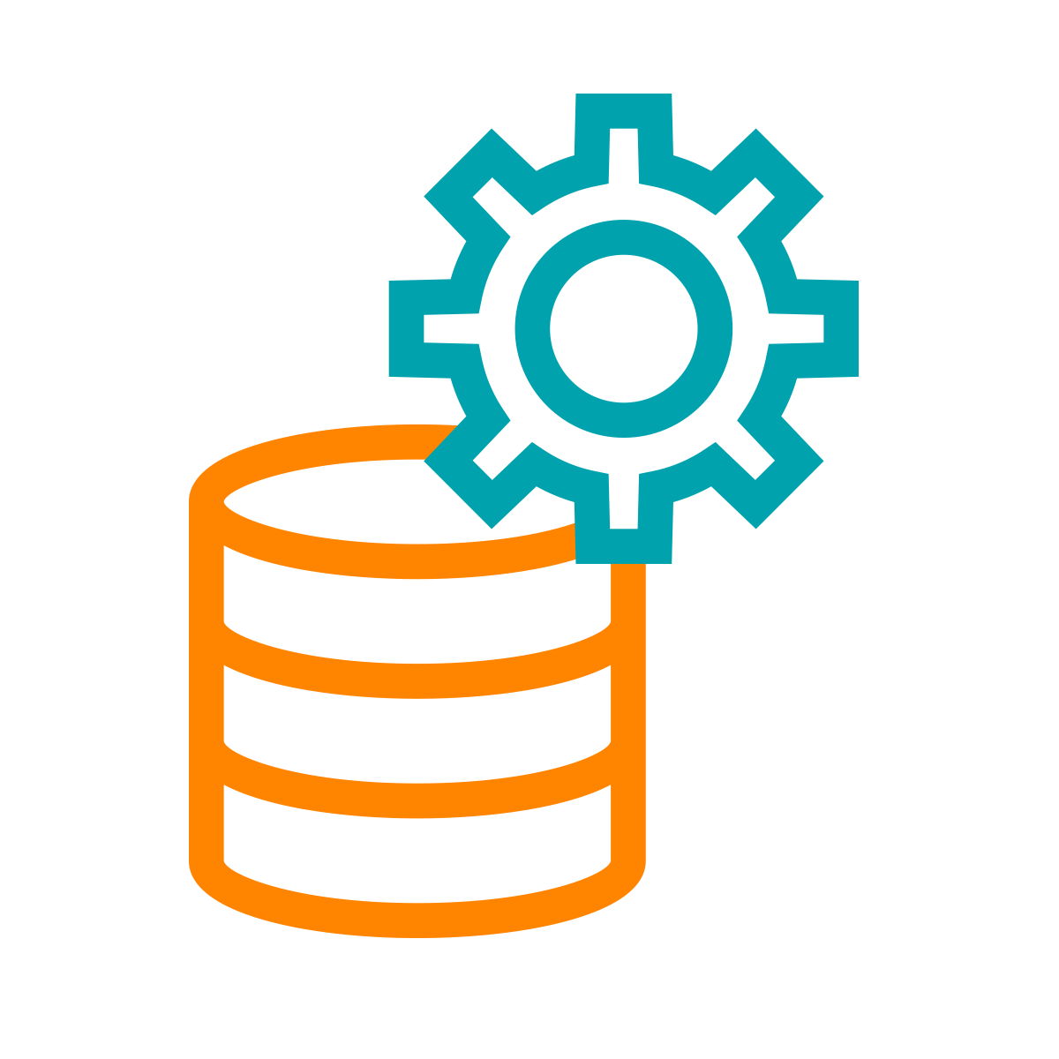

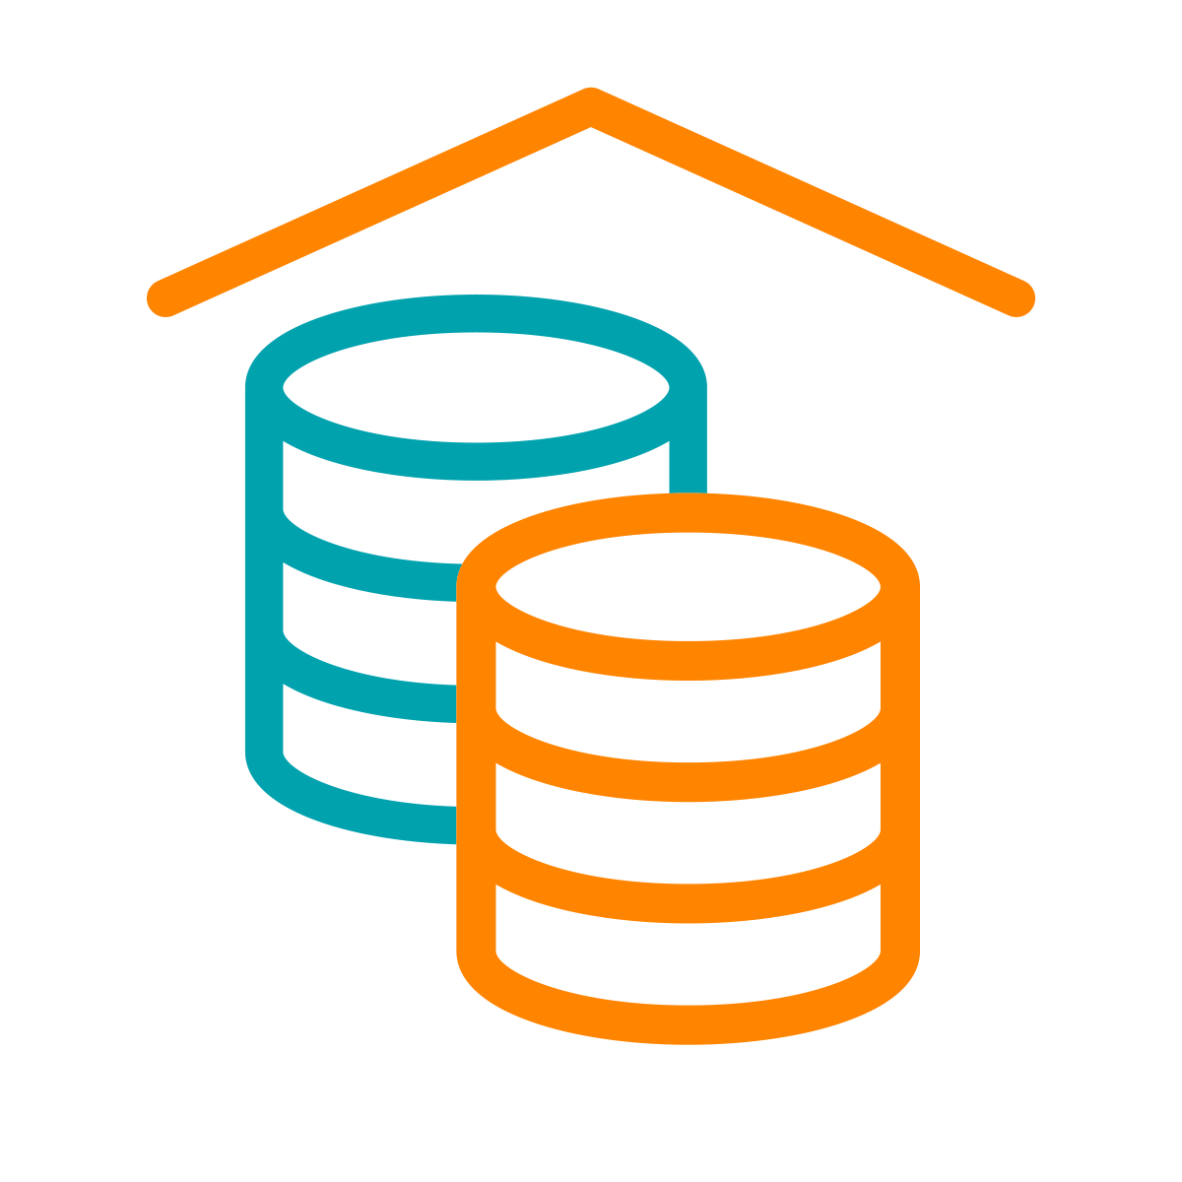
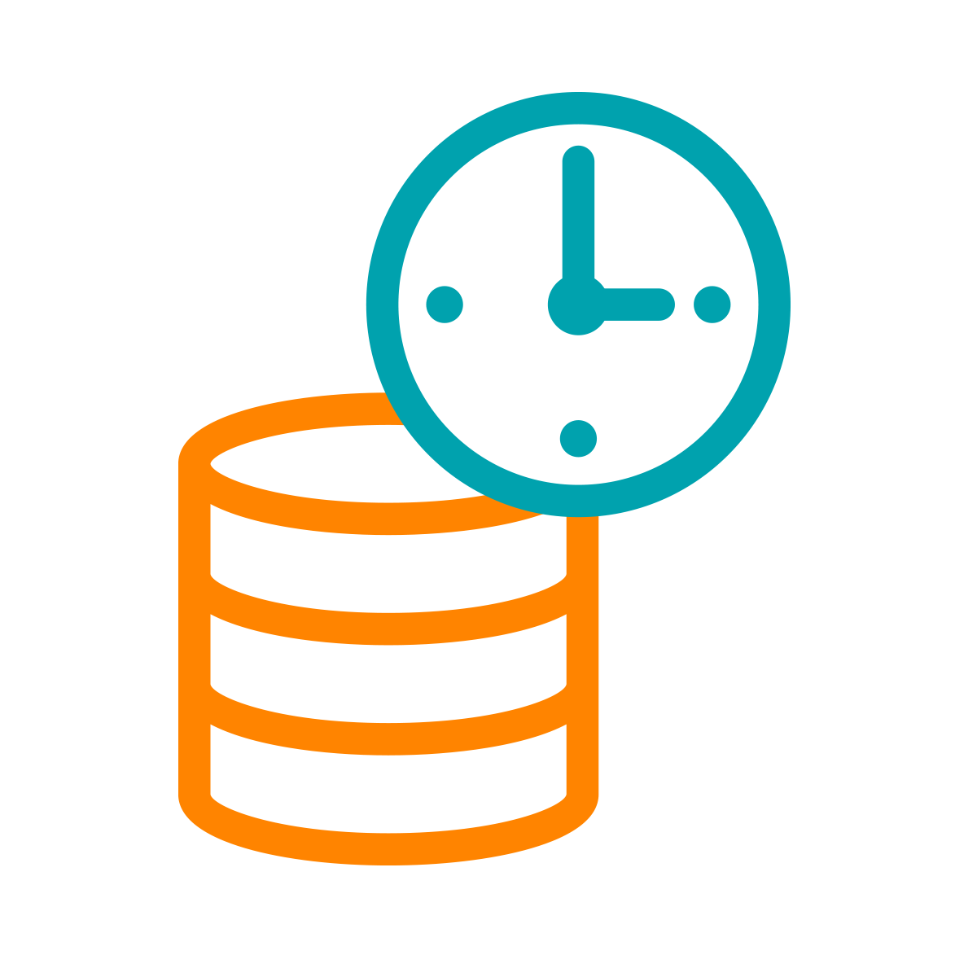

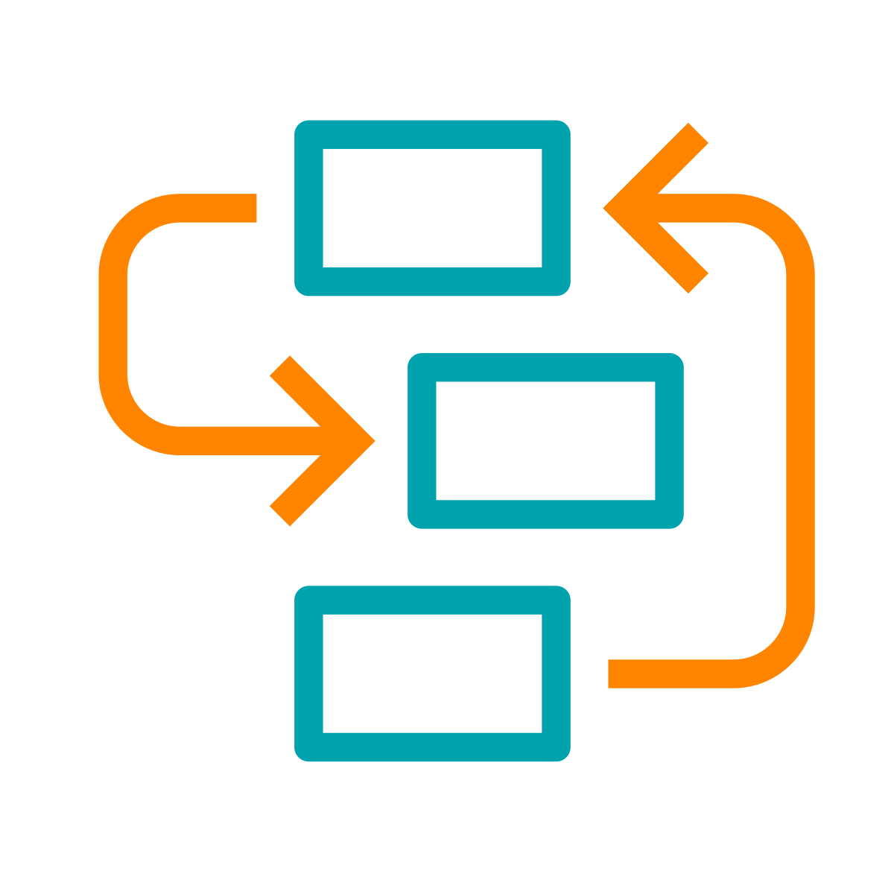










A HYBRID / MULTI-CLOUD DATA PLATFORM AND AN INTEGRATED SUITE OF SECURE ANALYTIC APPS
Real-time
Batch
Structured
Unstructured
Data Collection
Data
Engineering
Virtual Data Lake
Data Warehouse
Operational Database
Streaming Analytics
Machine Learning
Data Visualization
Analysts
Engineers
Scientists
Developers
Data Sources
Data Users
Cloudera Data Platform
Data Lifecycle integration for better user productivity and faster time to value
Hybrid & Multi-Cloud to leverage existing investments and reduce risk
Secure & Governed to simplify data protection, sharing and compliance
Open & Extensible to support more use cases faster and at lower cost

Slide 5
CDP HYBRID CLOUD
Consistent operations and analytics experiences across private and public clouds
Analytic Experiences
Analytic Experiences
MANAGEMENT CONSOLE DATA CATALOG | REPLICATION MANAGER | WORKLOAD MANAGER
CDP Private Cloud
CDP Public Cloud
DF
DE
DW
OD
ML
DF
DE
DW
OD
ML
K8S Containers - OCP, OKE, etc.
K8S Containers - EKS, AKS, etc.
Base
Base
FILE & OBJECT STORE HDFS | OZONE
DATA HUB
OBJECT STORE S3 | ADLS
DATA HUB
Bare Metal Servers
Virtual Servers

Slide 6
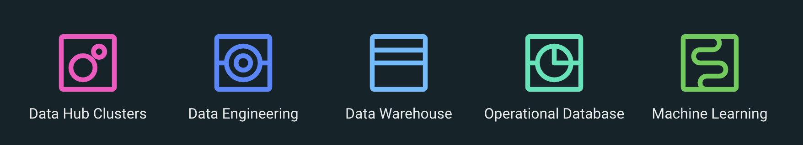
DATA HUB CLUSTERS AND EXPERIENCES
What are the consumption options?
A Data Hub Cluster is a customizable environment that runs like a traditional Hadoop cluster, but is designed to leverage Cloud Storage.
An Experience is a container-based compute environment for specific purposes: ML, DW, DE, OD, DF

Slide 7

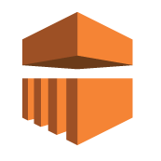
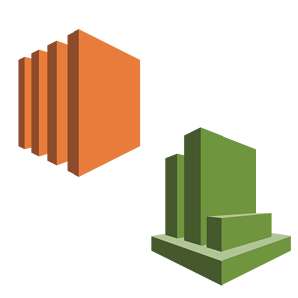
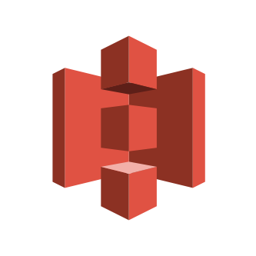
CASE STUDY: FINANCIAL SERVICES CUSTOMER
Customer saves $10M
Before CDP
After CDP
Amazon EMR
Amazon EC2
Amazon S3
$300K
$12-16M
$850K
$3M
Notes:
Customer - This is a projection…
“Fin Serve customer”... - Containers - EMR/HDI...etc. leverages VM’s….for DW and ML we leverage containers and also give you the ability to leverage a set of shared services which neither leverage…
-- Permanent ~large node cluster on IAAS...
Performance/Innovation - EMR (Just announced LLAP) Their words More than 2 X faster….Net result - -> 2X Cheaper….
-- ACID Compaction
-- Elasticity
--
Reach out to the Value Mgmt team ….to dive in with specifics of your customer…
--

Slide 8
COMPETITIVE LANDSCAPE
Cloudera stands out as a hybrid and multi cloud platform for data management and analytics with enterprise security and governance powered by open-source innovation
 | CLOUDERA DW,ML,DE,OD,DF | CLOUD ONLY Databricks, Snowflake, Confluent | PUBLIC CLOUD EMR, Dataproc, HDI, Redshift, Sagemaker
Hybrid & multi-cloud
Common security & governance
Integrated data lifecycle
Open & extensible
Notes:
Unlike basic business analytics services, only CDP has enterprise capabilities built-in
Security
Fine-grained access controls, LDAP, DNS, Kerberos, TLS, Web UI proxies, web UI authentication, authorization, and auditing
Governance
End-to-end lineage to prove data access and usage, even across transient clusters
Integration
Shared data experience that enables multiple analytics services to operate on shared data securely, with data catalog, replication manager
Scale
Proven architecture operates multiple analytics, governance, security, and shared data at scale – on PetaBytes of data for 1,000s of users
Hybrid
Runs on AWS, Azure, soon GCP, and on-prem – storage and compute

Slide 9
Moving Customers to CDP - What’s in it for you?
It's not just an upgrade - it’s about re-architecting the data infrastructure to be truly Hybrid / Cloud-Native
Great opportunity for both high-value consulting as well as project delivery services
Delivers a cloud-native platform for the client that can handle many varied data workloads
Deeper strategic client engagements with longer, multiple cycles
Deliver both cloud strategy and data strategy without compromise
Lower-risk integration of multiple data workloads in a single platform
Take advantage of AWS/Azure funding

Slide 10




Opportunities ahead of us
Cloudera Data Platform (CDP)
CDP Upgrade from CDH & HDP
New Workloads for existing customers
Point workloads for new customers
Data Life Cycle Projects for new customers
3-way partnership – You, Cloudera and Redhat – winning Private Data Cloud Business
3-way partnership – You, Cloudera and Cloud Infrastructure Vendors (AWS, Azure &GCP) – Winning Public Data Cloud business
Notes:
CDP Upgrades 🡪 Identify and work on upgrading CDH & HDP customers to CDP
Existing Customer 🡪 New Workloads 🡪 DF, DE, DW, OD & ML
New Customer 🡪 Single workload 🡪 With CDP Public Cloud
New Customer 🡪 Data Life cycle workloads for Digital Transformation 🡪CDP Public Cloud & CDP Private Cloud
Tap & work with Redhat Openshift BU for Hybrid Proposition 🡪 Identify clients using Cloudera & Red Hat OpenShift - great targets for CDP Private Cloud

Slide 11
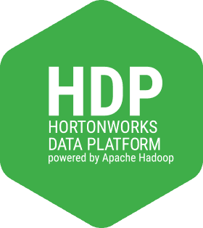
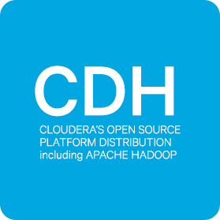
THE PATH
Existing
Customers
On-Prem Migration
In-Place Upgrade
CDP Private Base
CDP Private Experiences
CDH5/HDP2/HDP3 only
New Workloads
New Cluster Deploy
Direct to Cloud Migration
New Customers
CDP Public Cloud

Slide 12
MIGRATION PROCESS OVERVIEW
Scoping and Planning
Dev CDP Cluster Installation
App Dev and Test
UAT / Pre-Prod Migration
Live Migration
Workshops for identification of risk areas, migration strategy (in place, side-car, target version).
Planning for next steps
Perform installation of new cluster or upgrade of existing dev environment for dev and test purposes.
Tenant(s) work to test against newer versions and perform code modifications if required.
Development and execution of a real-life upgrade/migration.
Used to rehearse and finalise cut-over activities and backup/restore strategy
Prod migration and go-live, DevOps integration readiness
Installation of production cluster
Where doing side-car migrations, cut over of tenants or workloads on an individual basis.

Slide 13
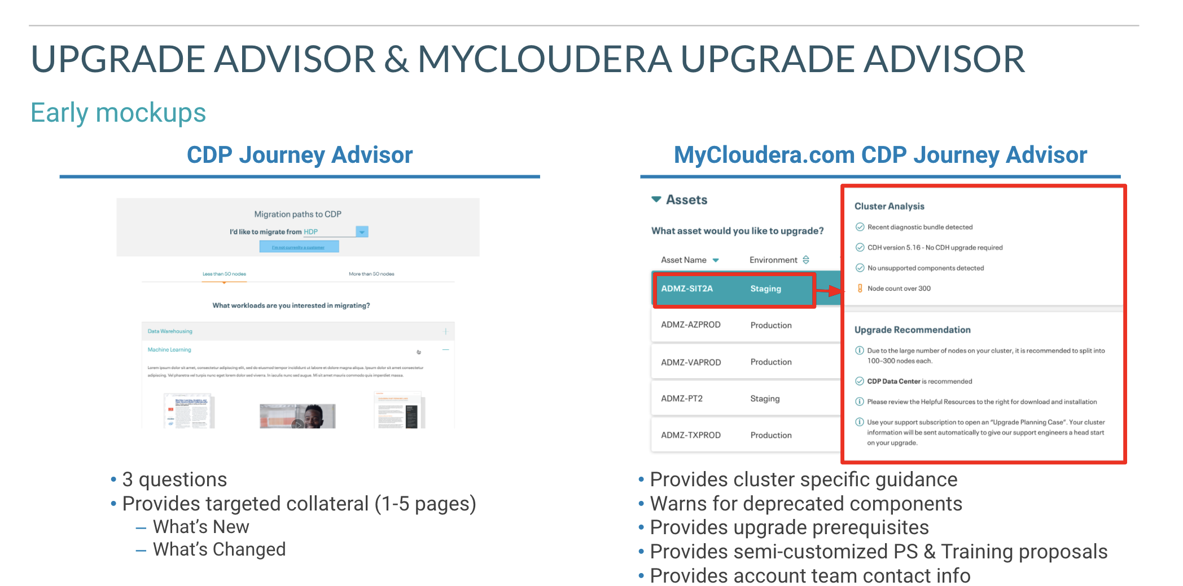

Slide 14
Migration to CDP Private Cloud

Slide 15
PATHS TO CDP PRIVATE CLOUD BASE
Migrate to Private Base | Upgrade to Private Base
Build a new CDP Private Cloud Base cluster on-premises; copy data and metadata from existing classic cluster; and migrate existing workloads. | Upgrade from classic cluster to CDP Private Cloud Base in-place on the same hardware infrastructure.
Use this when: Customer has new hardware/spare capacity Can afford higher overall transition time Requires more granular cutover/failback capabilities | Use this when: Customer has limited spare capacity Has fewer tenants / integrations Can afford a single-cutover with limited rollback options
CDP
CDP
Notes:
We have two main paths to for existing customers to get to CDP Private Cloud, a migration to a new CDP cluster (also known as sidecar migration) and an in-place upgrade. Side-car migrations can actually be rolling migrations as well, by cycling out existing nodes in batches into a new cluster, as workloads are transitioned across.
Migrations
Advantages
Lowest risk: leaves original hardware untouched until decommissioning
Validated workloads and datasets can migrate when they're ready
One failed workload doesn't block the process or cause a rollback
Requires little/no planning of the ordering and timing of workload and dataset migration
Low degree of tenant collaboration required
Migration rather than upgrade
Disadvantages
Requires additional hardware
Failed workload migration would cause delays to decommission process
When to Consider
Whenever it’s a possible option - this is the default, recommended strategy
When existing hardware is scheduled to be replaced
Upgrades
Advantages
Well understood process by all participants
Simplest cutover process - all workloads and datasets upgrade at the same time
Doesn't require additional hardware
Universal process that can be used with any cluster
Disadvantages
Highest risk since everything changes at once
All workloads and datasets need to be validated before the upgrade can proceed
Validation requires extensive testing
One workload that fails after upgrade could cause a full rollback
Upgrade/Rollback are destructive operations and are all-or-nothing
When to Consider
When there is no additional hardware available for a sidecar upgrade
When there is not enough spare capacity for a rolling upgrade
When it is too difficult to disentangle complex data and workload dependencies

Slide 16

CDP RUNTIME 7.1
CDP-PVC BASE CLUSTER
(Cloudera Runtime 7.1.6)
MANAGEMENT
Cloudera Manager 7.3.1
Workload Manager 2.1.0
Streams Message Mgr. 2.1.0
Replication Manager 1.5.0
Spark 3.1 separate parcel
COMPUTE ENGINES
Spark 2.4.5
Hive 3.1.3
HBase 2.2.3
A CDP Private Cloud Base cluster (powered by Cloudera Runtime), can serve as a traditional “data lake” (storage & compute) cluster, or as a “base storage cluster” (storage only) serving compute workloads running on Kubernetes.
This image shows the component versions in Cloudera Runtime 7.1.6.
Click HERE for the complete list of supported components.
Leverages Hive on Tez, not MR
Kafka 2.4.0
Impala 3.4.0
Phoenix 5.0.0
FRAMEWORKS
Capacity Scheduler 3.1.1
Parquet 1.10.99
Livy 0.6.0
FS -> CS Migration
ZK 3.5.5
ORC 1.5.1
Oozie 5.1.0
SECURITY &
GOVERNANCE
HMS 2.0.0
Ranger 2.0.0
Atlas 2.0.0
Knox 1.3.0
Many teams running HDFS 2.6.0
STORAGE
HDFS 3.1.1
Ozone 1.0
Kudu 1.12.0
This is the G.A. release
Notes:
Cloudera Runtime in CDP:PVC - 7.1.6
Cloudera Runtime in cloud - the latest is 7.2.10

Slide 17
CDP PRIVATE CLOUD DATA SERVICES ARCHITECTURE
Management Console
CML
CDW
CDE
CML Workspace
Virtual Warehouse
Virtual Cluster
CM
CDP PVC Base Cluster
Network
HDFS / Ozone
HMS
Ranger
Atlas
Data Lake
Spark-on-K8s
Python, R
Environment
Compute Capacity
Bare metal or VMs
Kubernetes Cluster
Notes:
Same core architecture for 1.2 and 1.3+. CDE was available in tech preview only on 1.2.

Slide 18
CDP PRIVATE CLOUD 1.3 DATA SERVICES ARCHITECTURE
Management Console
CML
CDW
CDE
CML Workspace
Virtual Warehouse
Virtual Cluster
CM
CDP PVC Base Cluster
Network
HDFS / Ozone
HMS
Ranger
Atlas
Data Lake
Spark-on-K8s
Python, R
Environment
Compute Capacity
Bare metal or VMs
Kubernetes Cluster
Can be OpenShift OR ECS
Notes:
OpenShift is obtained through Red Hat

Slide 19
WORKLOAD MANAGEMENT IS MORE FLEXIBLE AFTER UPGRADING TO CDP
T3 T4
Experiences
Cluster
Cluster
Cluster
Cluster
T1 T2 T3 T4
Docker
Experiences
T1 T2 T3 T4
T1 T2 T3 T4
T1 T2 T3 T4
T1 T2 T3 T4
Compute Engines
Compute Engines
Compute Engines
Cluster
Compute Engines
Docker
SDX
SDX
SDX
T1 T2
SDX
Compute Engines
Cluster
Storage
Storage
Storage
Storage
SDX
SDX
Storage
Storage
Option 1
Option 2
Option 3

Slide 20
PATH TO CDP PRIVATE CLOUD BASE AND EXPERIENCES
1
2
3
4
5
Prerequisites
CDP PVC Base Install/Upgrade
Data Migration
CDP Private Cloud Install
DW/ML Use Case Onboarding
RedHat OCP Install

Slide 21
Migration to CDP Public Cloud

Slide 22


CDP Public Cloud – Key Benefits
There are a number of common benefits that CDP delivers
Simplify Data Analytics
You Own Your Data
First Class Security
Hybrid Flexibility
Common Skill Set
Data Lifecycle
Easy and Portable
Notes:
FASTRACK TO CLOUD
Common themes across many of the conversations Paul and I have with customers, wanted to share these and as we go through we will show you how most of the value drivers ultimately link back to these.
CDP is PaaS:
CDP is an automated PaaS platform
Pain free automated deployment and destruction of secured clusters integrated with your environment
Significantly reduce admin overheads with automation and goverannce tooling
Patching / Upgrades and enhancements all done by Cloudera
No lock-step upgrades - multiple versions running at once in different clusters
Data in your VPC:
All data stays in your VPC - this is a theme because it is not the case with competition
We never move it or touch it !
One data set for all functions on the platform - no data silos
Own relationship with cloud vendor
Integrated security
Consistent Security and Governance
Set once at an environment level, inherited by all use case.
Full integrated and out of the box
Hybrid Flexibility:
Cloudera Runtime
Move the workloads that are right for cloud
Deliver onprem capability via Private cloud
Gives you flexibility and choice
Can start developing and testing in the cloud, and bring back on prem later if needed - same tech everywhere
Same Skill Set
Use the same skills developed on prem in the cloud - we have made it easier to manage and consume but same underlying tech
No need to re-skill in new tools
Instantly start delivering value in CDP
Multi-Function
Rich Multifuncion capabilities
Flexibility and choice of Datahub
Cloud native experiences with DW and ML including autoscale and kubernetes
All on same underlying data in your VPC
Easy Migration
Inbuilt tools provide easy migration path
Move data, metadata and security via replication manager
Not big bang conversion required - derisks

Slide 23



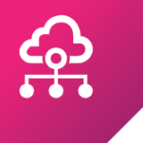

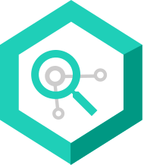


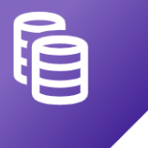



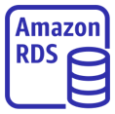


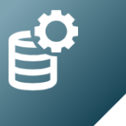
CDP - AWS HIGH LEVEL ARCHITECTURE
Customer AWS Account
Cloudera Cloud
FreeIPA Services
SDX Data Lake
K N OX
Data Hub
User
KDC
Ranger
Cloudera Runtime (all services)
Features:
PaaS
Manual Scaling
Custom Templates
Data Catalog
LDAP
Atlas
EC2
S3
DLM
In-built definitions
CLI
Replication Manager
DNS
IDBroker
BDR
Data Warehouse Experience
Web UI
CA
Hive Metastore
Hive (w LLAP)
Features:
PaaS
Fast Auto Scaling
JDBC connectivity
Workload Analytics
SAML Federation
Cloudera Manager
Impala
SDK
Identity Management
EKS
S3
DAS & Hue
ID Broker Mapping
Amazon EC2
Mgmt, Orchestration, & Monitoring Services
Amazon EC2
Machine Learning Experience
ML Workbench
Features:
PaaS
Fast Auto Scaling
GPU support
S3 Storage
EKS
S3
Spark
Control Plane APIs
Amazon RDS
Python/R
Data Engineering Experience
Cross Account Access IAM Role
S3 Storage
Spark
Features:
PaaS
Fast Auto Scaling
Job Management
Amazon IAM
EKS
S3
Airflow
KNOX
Safari (perf-mon)

Slide 24

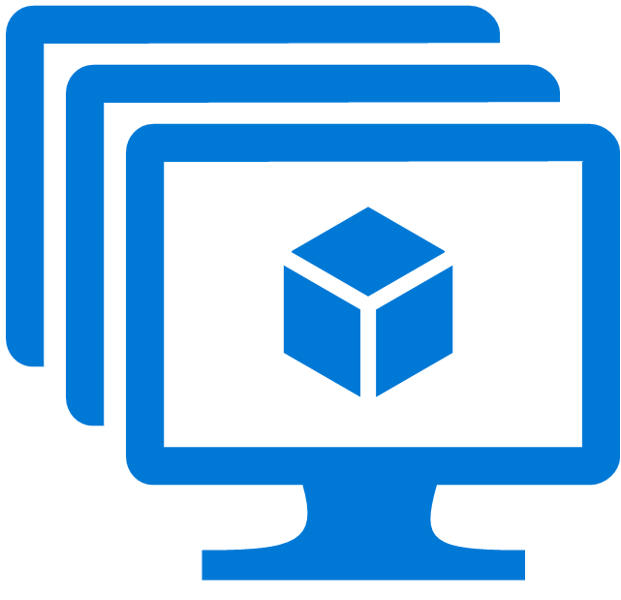
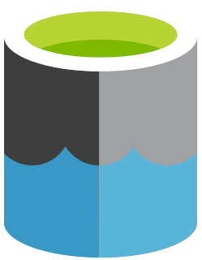
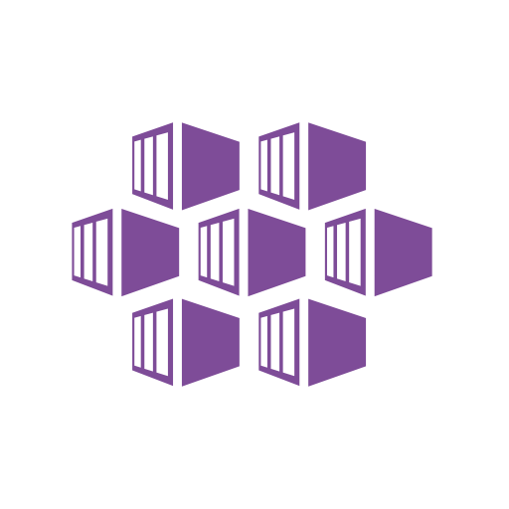


CDP - AZURE HIGH LEVEL ARCHITECTURE
Customer Azure Resource Group
Cloudera Cloud
FreeIPA Services
SDX Data Lake
K N OX
Data Hub
User
KDC
Ranger
Cloudera Runtime (all services)
Features:
PaaS
Manual Scaling
Custom Templates
Data Catalog
LDAP
Atlas
VMs
ADLS Gen2
DLM
In-built definitions
CLI
Replication Manager
DNS
IDBroker
BDR
Data Warehouse Experience
Web UI
CA
Hive Metastore
Hive (w LLAP)
Features:
PaaS
Fast Auto Scaling
JDBC connectivity
Workload Analytics
SAML Federation
Cloudera Manager
Impala
SDK
AKS
ADLS Gen2
DAS & Hue
Identity Management
ID Broker Mapping
VMs
Mgmt, Orchestration, & Monitoring Services
VMs
Machine Learning Experience
ML Workbench
Features:
PaaS
Fast Auto Scaling
GPU support
ADLS Gen2
AKS
ADLS Gen2
Spark
Control Plane APIs
PostgreSQL
Python/R
Data Engineering Experience
AAD App/w
Contributor Role
ADLS Gen2
Spark
Features:
PaaS
Fast Auto Scaling
Job Management
Access Control
AKS
ADLS Gen2
Airflow
KNOX
Safari (perf-mon)

Slide 25
MIGRATE TO PUBLIC CLOUD
Management Console
Data Catalog
Workload Manager
Replication Manager
Process
Set up public cloud environments
Register classic cluster(s)
Identify candidate workloads
Migrate workload data and metadata using Replication Manager (“Burst to Cloud”)
Test and promote to production
Classic Environments
Public Cloud Environments
shift
Apps / Workloads
DF
DE
DW
OD
CML
Platform
CDP Runtime 7
CDP
Metadata
(Ranger/Sentry, Atlas/Nav, HMS.)
SDX
copy
Data
HDFS
S3, ADLSv2, ...
Notes:
Identify existing workloads as candidates for testing and migration using WXM
Copy existing data, metadata and policies using Replication Manager
Workload XM - CDH based

Slide 26
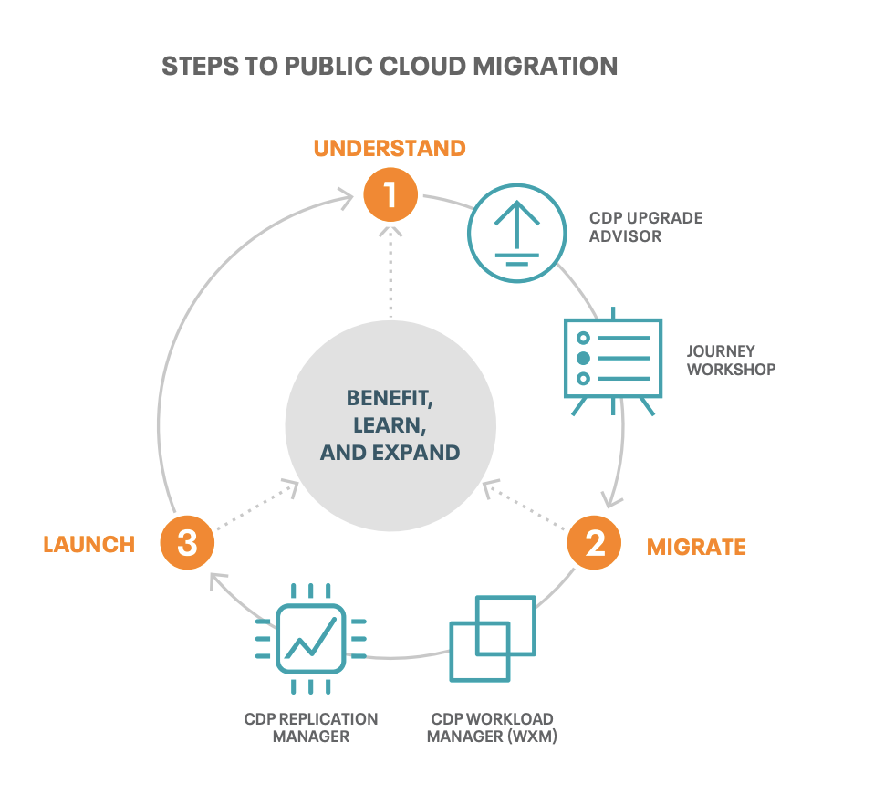
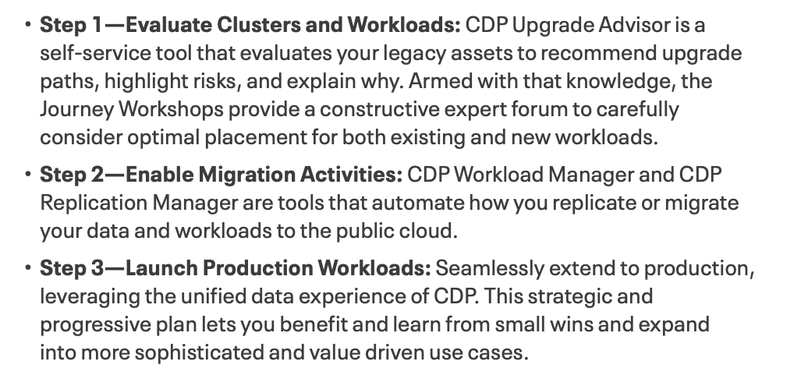
CDP Public Cloud Migration

Slide 27
Using WXM to migrate to
CDP Public Cloud
Value proposition
Generate ‘cloud friendliness’ Score
Auto-generated sizing / capacity plan for target environment
Automated Replication plan
Mitigate risk of run-away costs in the cloud due to suboptimal workloads
When to use WXM
Explore cluster & workload health before migration
Identify right workloads to migrate
Optimize workloads before migrating

Slide 28
PLAN: HIGH LEVEL SCHEDULE FOR MIGRATION PILOT
Scope of services include setting up CDP Data Center with Security and deploying workloads inscope to develop a production deployment plan.
 | Week 1 | Week 2 | Week 3 | Week 4 | Week 5 | Week 6
Kick Off and Health Check
Assessment, Solution & Planning
CDP PC Deploy & Secure
Cloud & CDP Training
Pilot Workload Migration
Demo and Validate
Next Steps Plan & Prod. Proposal
Assumptions:
Pilot scope assumes 1-2 customer workloads
Pilot scope will be finalized during the pre-sales phase of the sales cycle. Customer will provide the data sets as extracts for pilot
Customer will provide all necessary resources for supporting anything outside of Cloudera ecosystem

Slide 29
Tools to expedite Migration

Slide 30


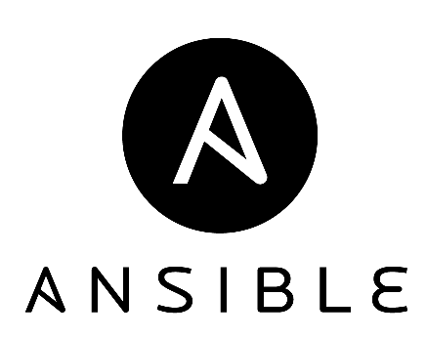



Automation Toolkit
Cluster Deployment
Ansible Automation deploys and fully secures a Private Cloud Base cluster in less than an hour
Improves repeatability and consistency when deployment multiple environments.
Sentry to Ranger Migration
Automatically migrate policies with Cloudera Manager and Replication Manager
Leverage as part of the upgrade process, data migration, backup/disaster-recovery scenarios
Cloudera Navigator to Apache Atlas
Upgrading tooling to migrate data lineage and catalog data
YARN Fair Scheduler to Capacity Scheduler
Built in mechanism to migrate configurations to equivalent settings

Slide 31
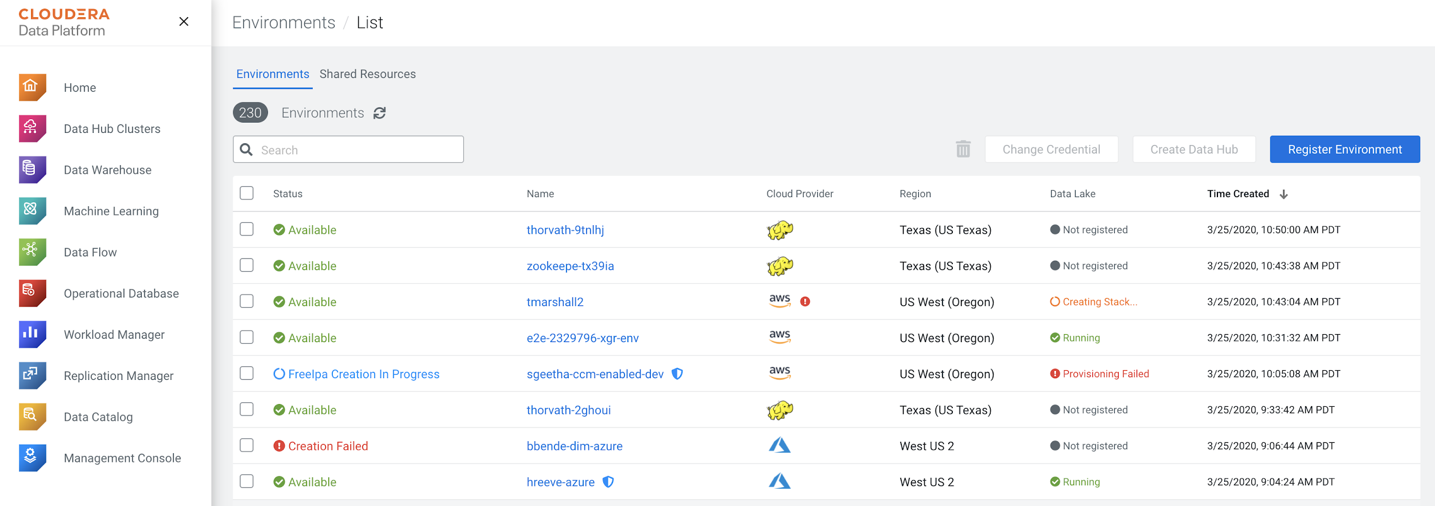
SINGLE PANE OF GLASS
All registered environments on-prem & cloud
Notes:
In order for replication to be setup -- all clusters must be registered. Cloud cluster registatration is automatic, but on-prem clusters must be manually added. Once this is done, you can see all your infrastructure in one place.

Slide 32
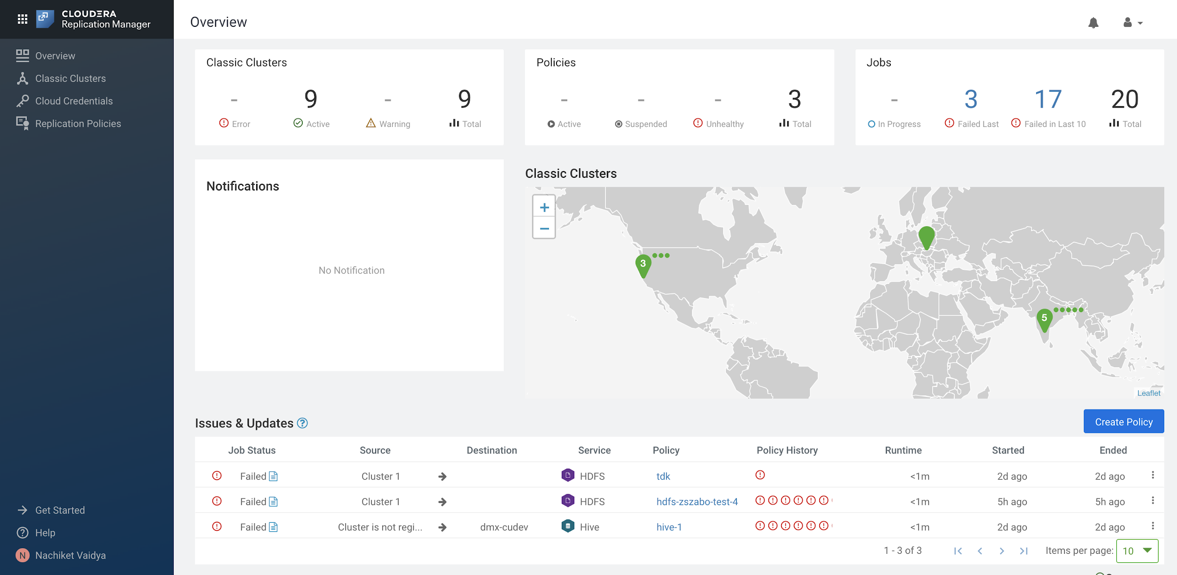
SINGLE PANE OF GLASS FOR ALL REPLICATION POLICIES
Notes:
Replication manager provides a single pane of glass for to see all your replication policies regardless of whether they are on-prem to on-prem, on-prem to AWS/Azure.

Slide 33
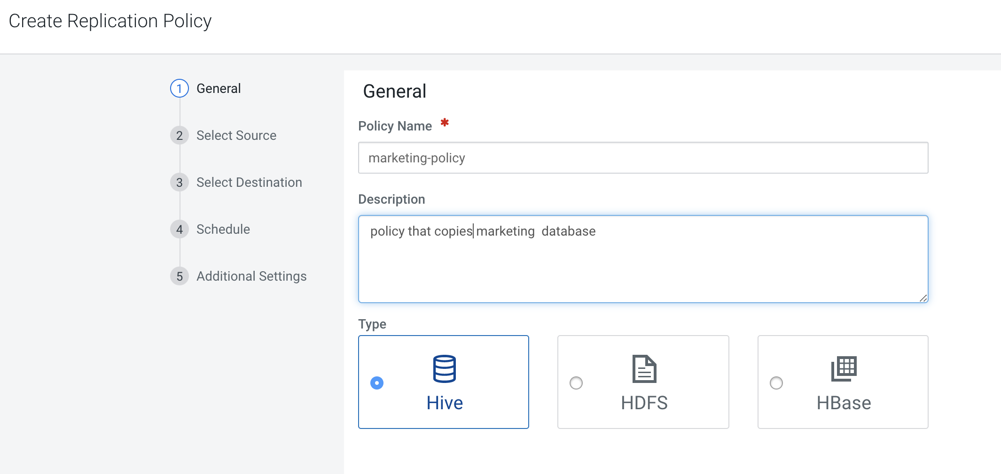
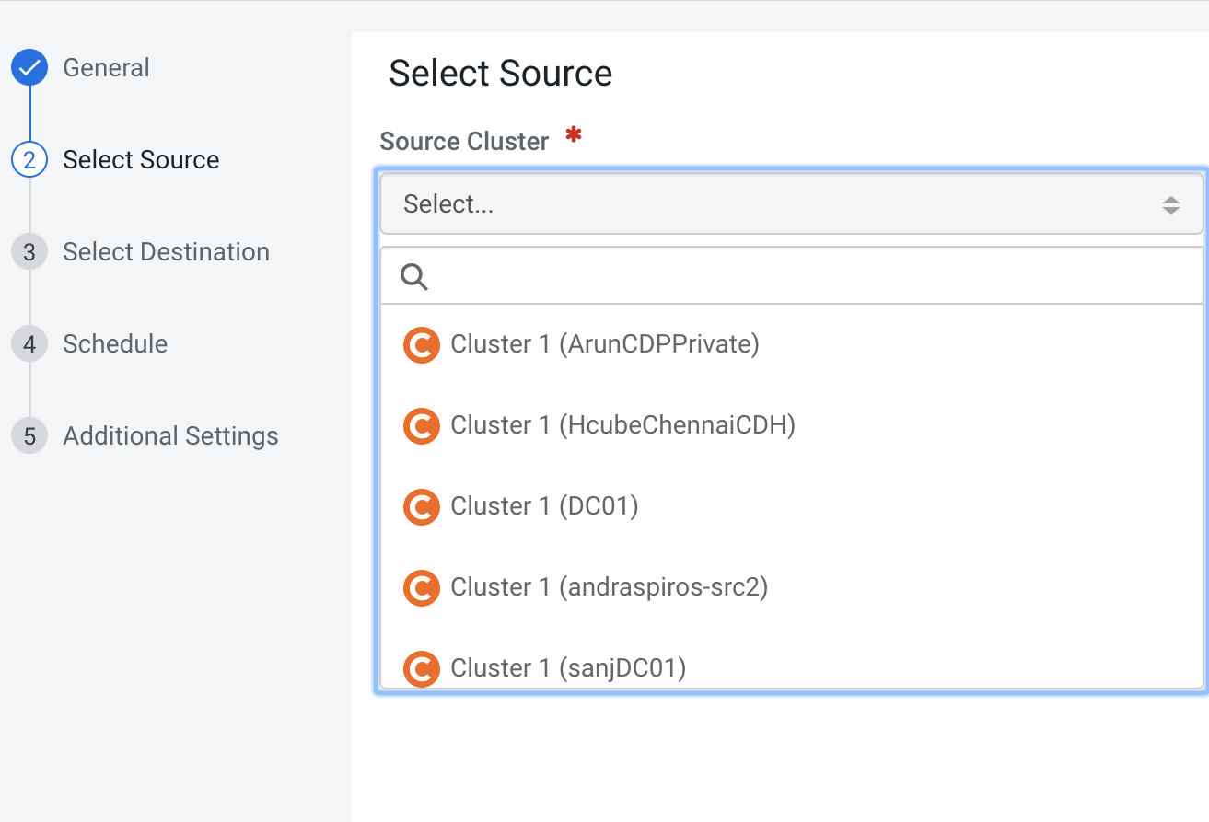
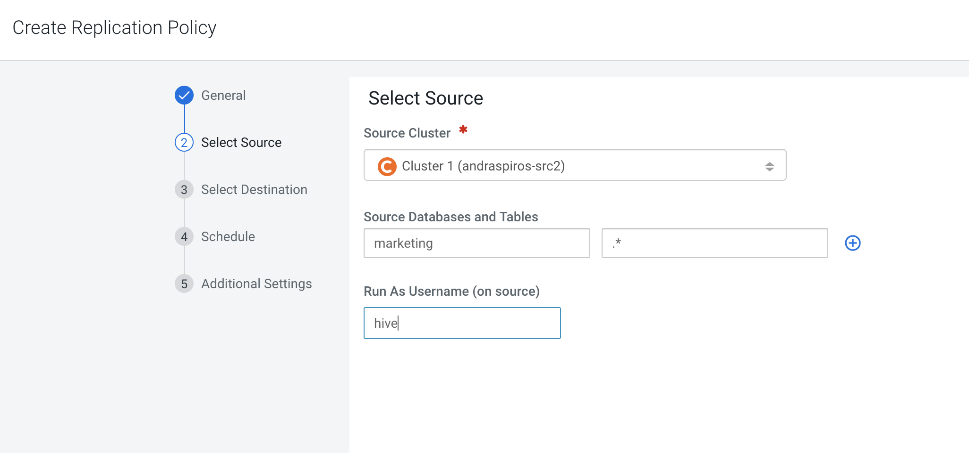
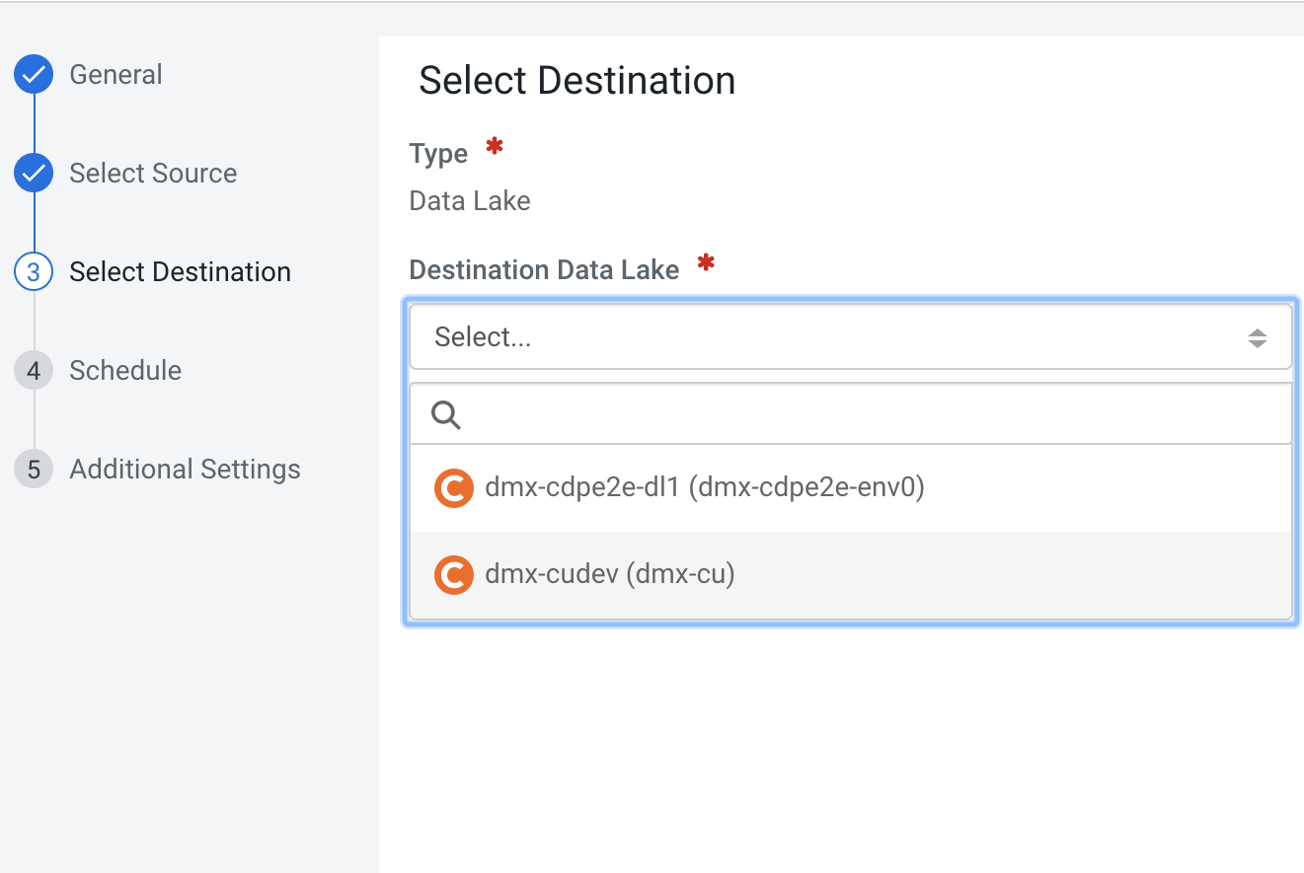
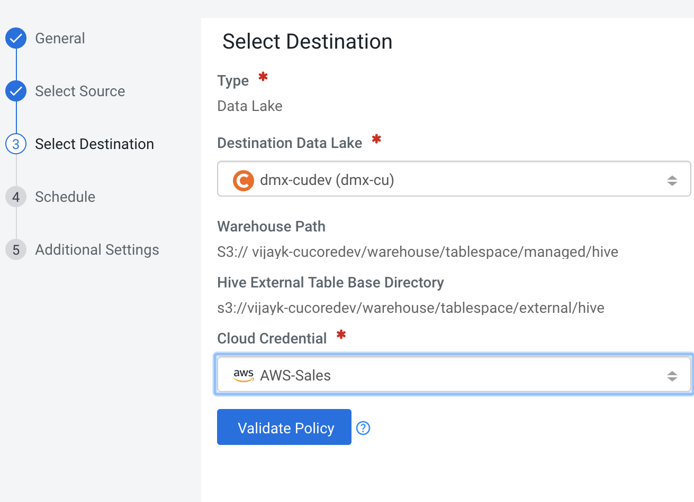
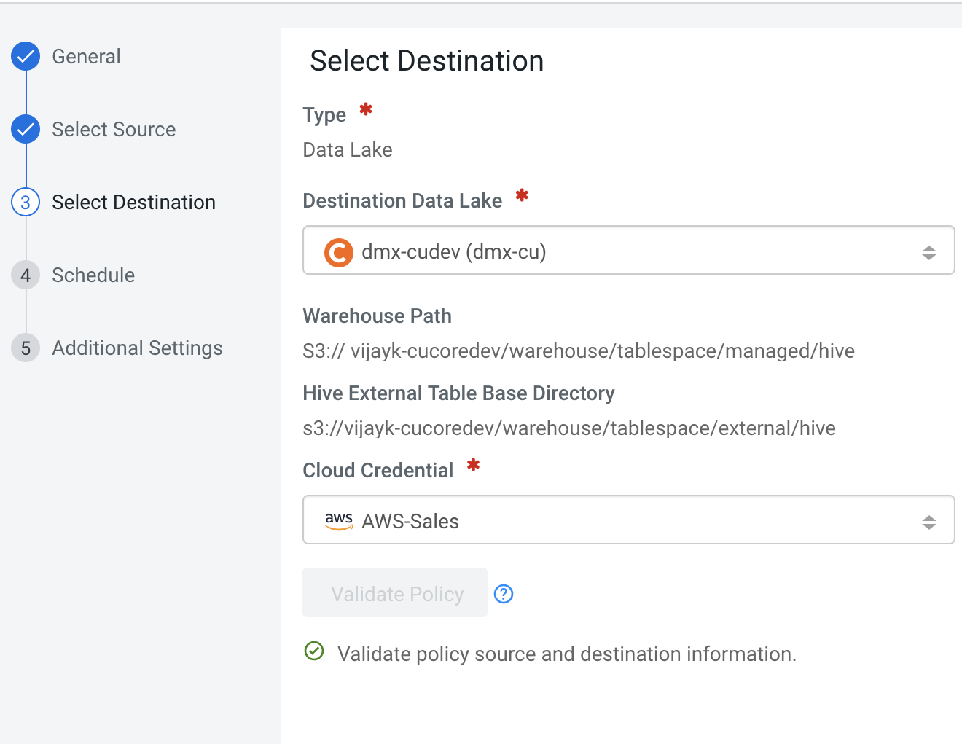
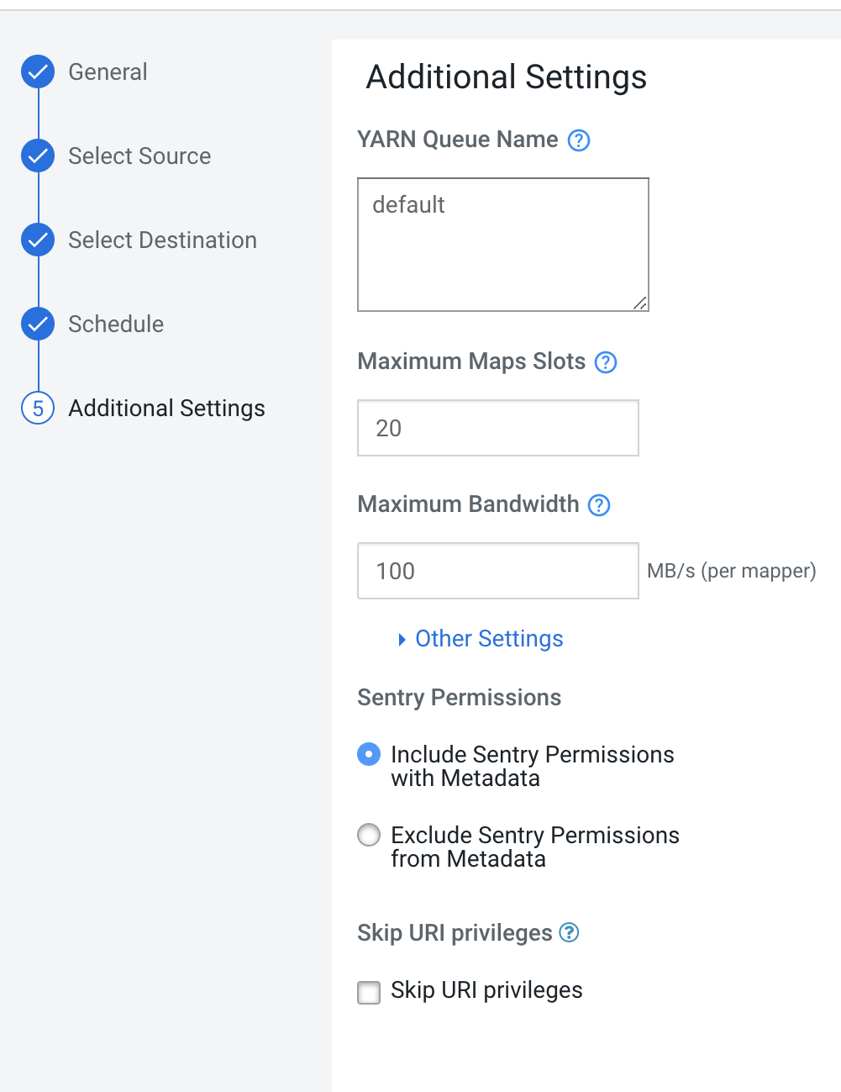
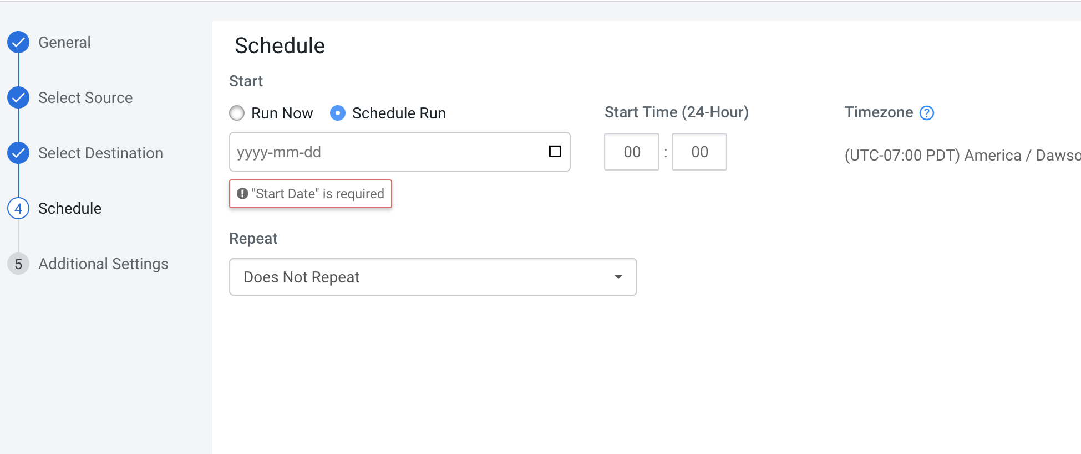
WIZARD BASED POLICY CREATION FOR DATA WAREHOUSE (HIVE & IMPALA)
1
2
3
4
5
6
Notes:
Replication policies are created through a simple wizard based interface. For Hive & Impala policies, there are 6 simple screens that are required for policy creation.

Slide 34

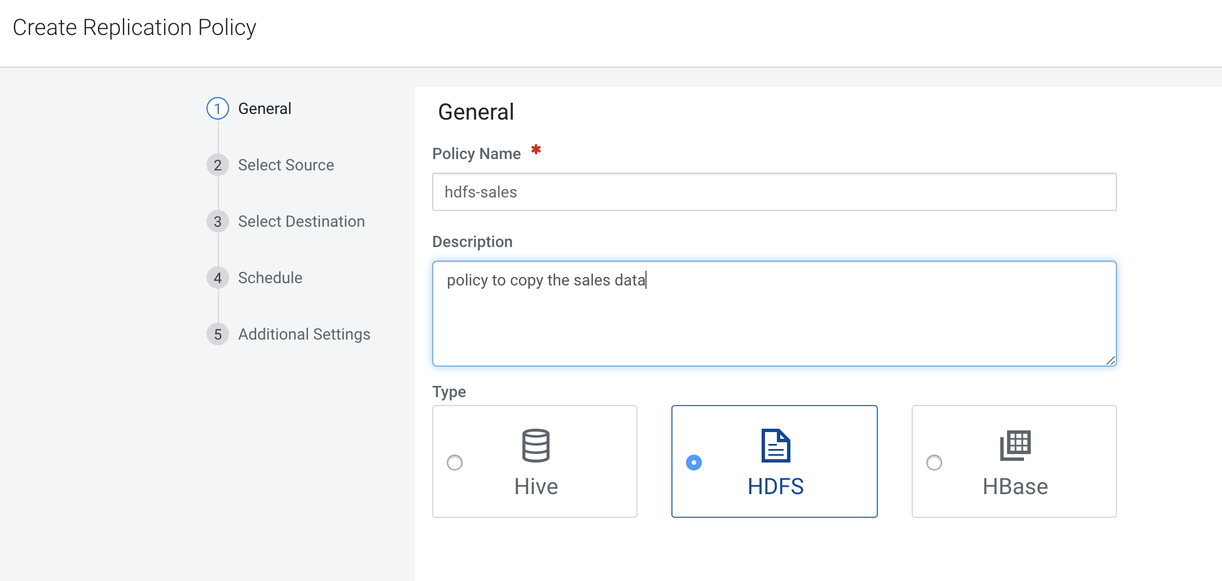
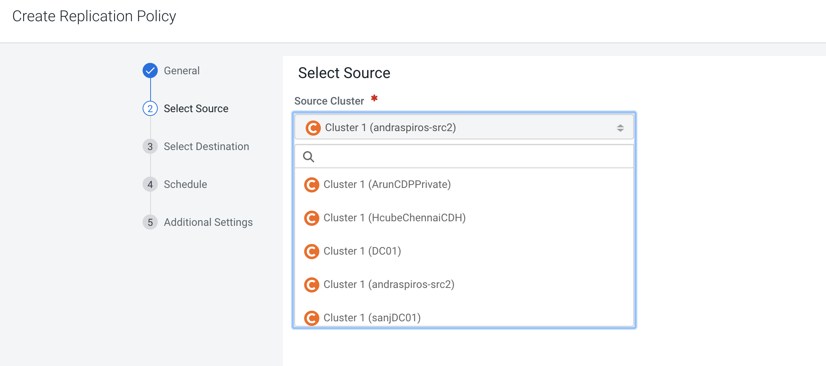
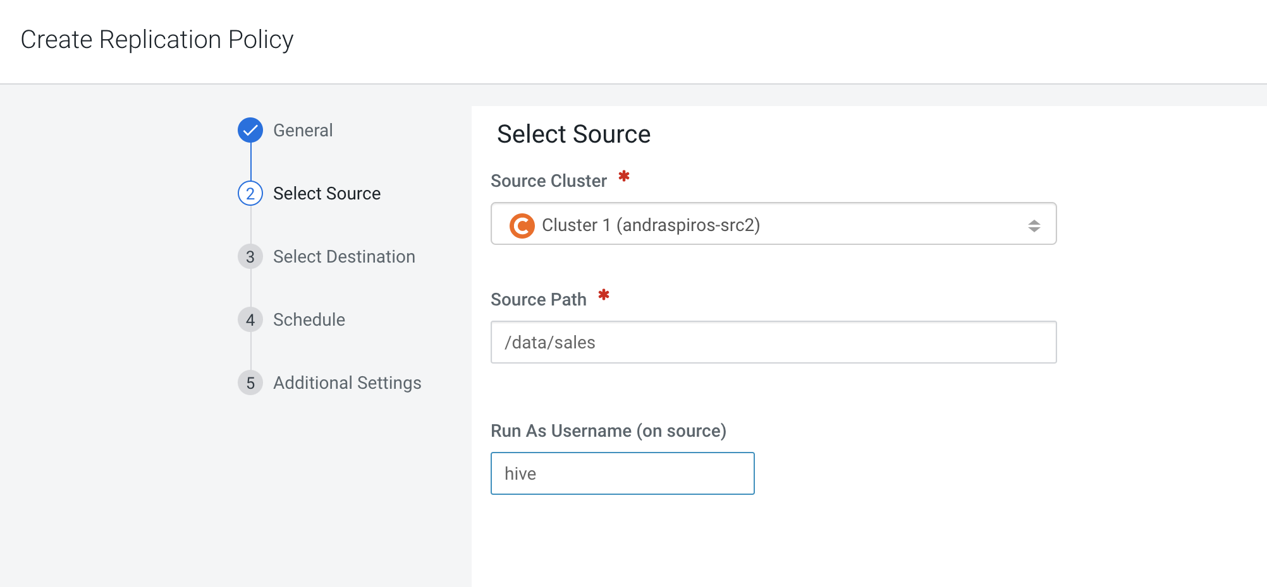
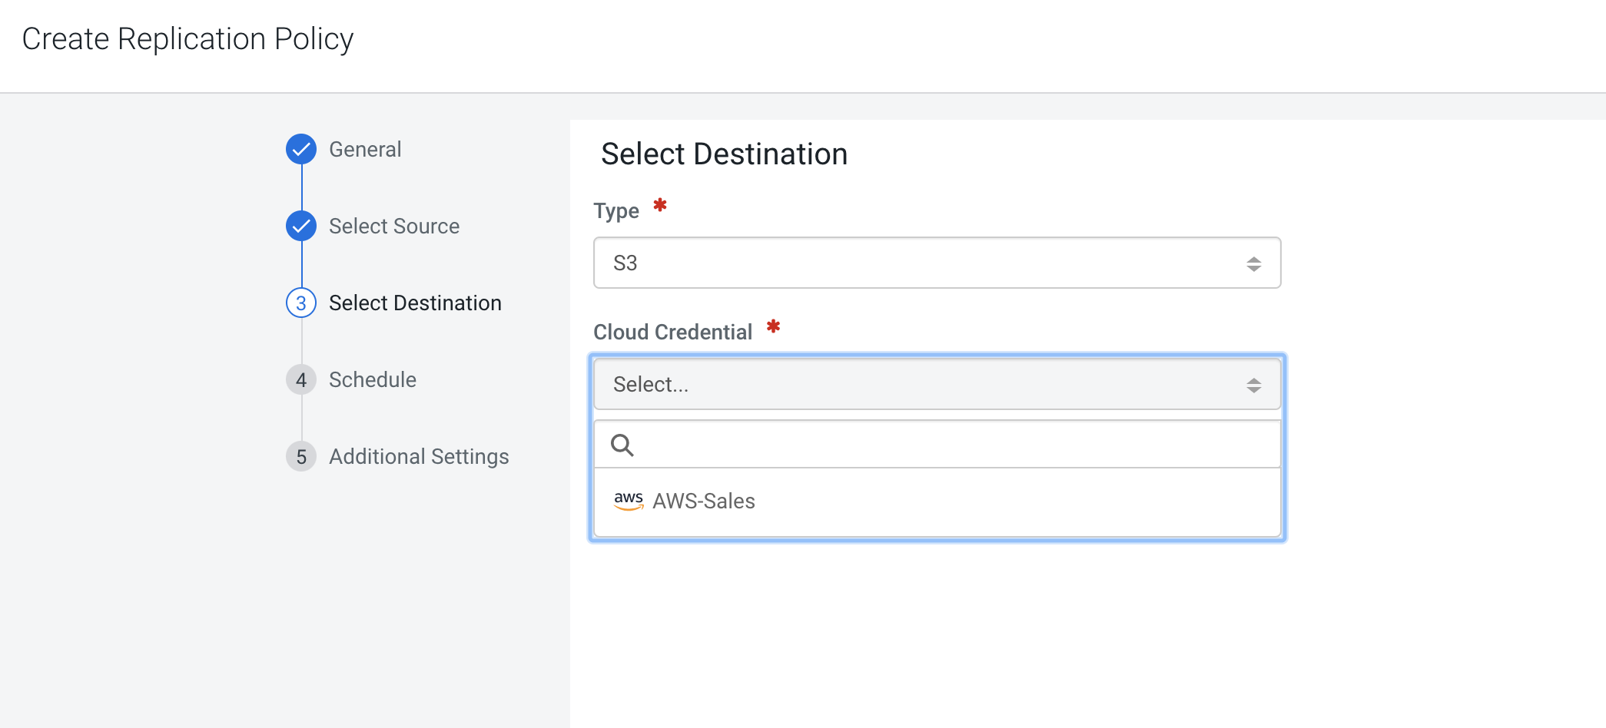
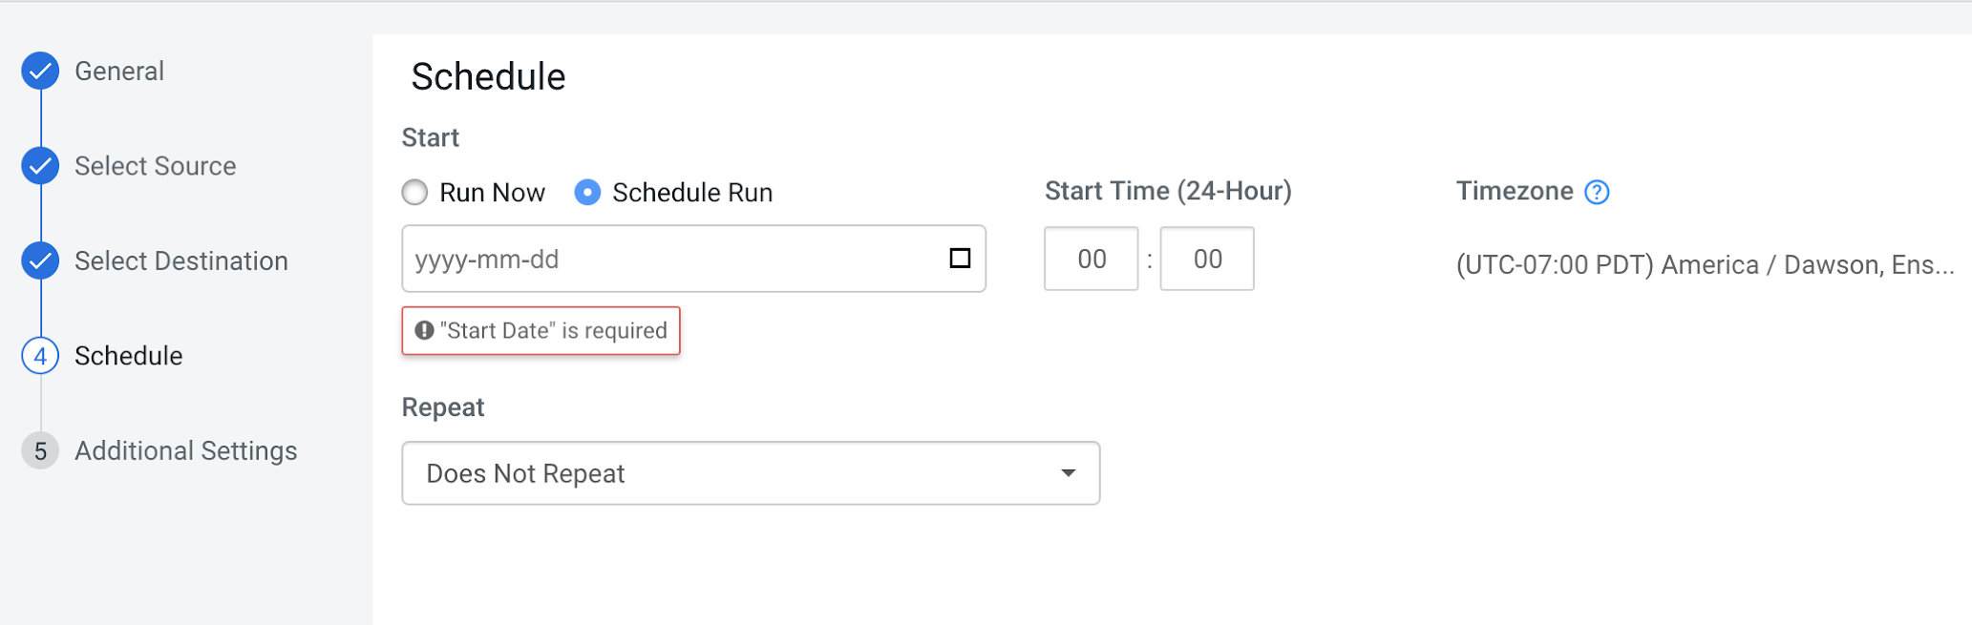
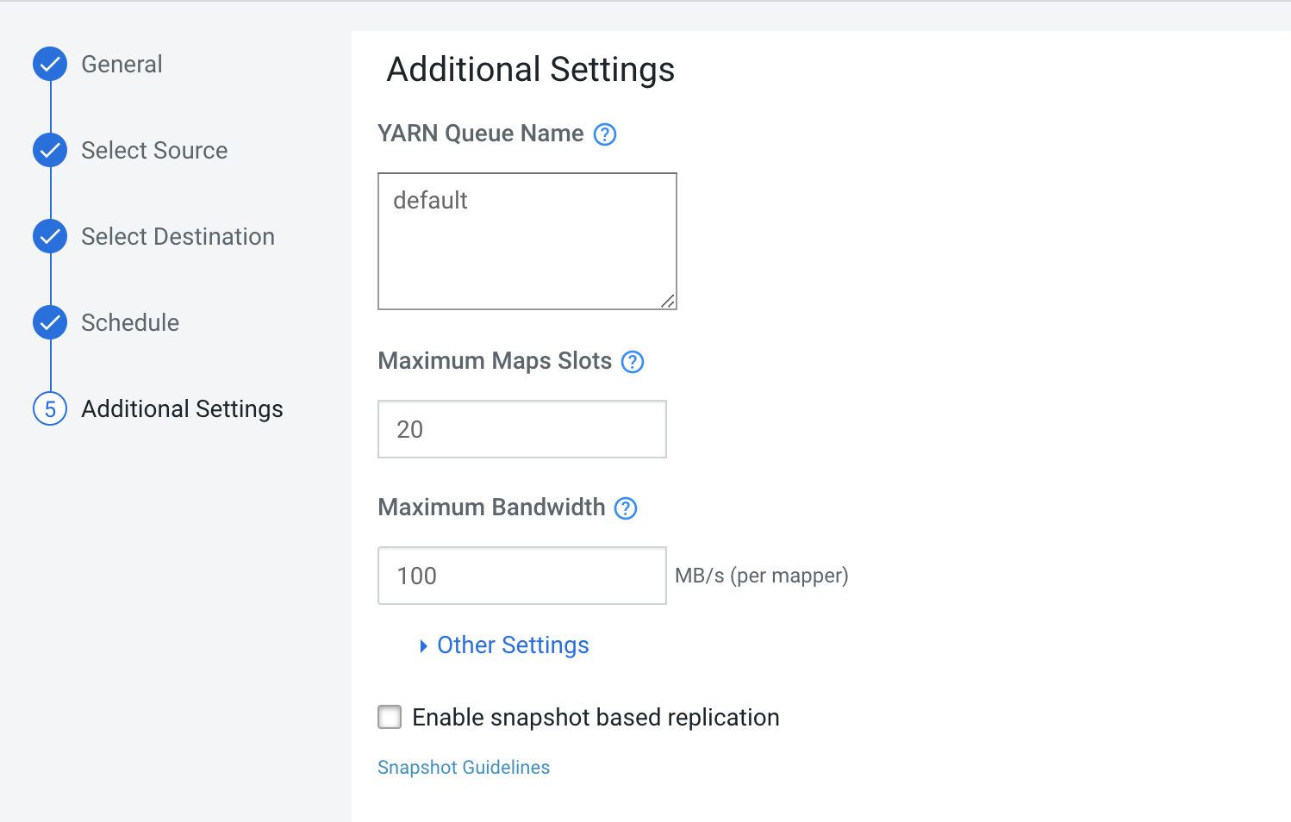
WIZARD BASED POLICY CREATION FOR DATA ENGINEERING & DATA SCIENCE (HDFS)
1
2
3
4
5
6
Notes:
HDFS policy creation is very similar to DWH policy creation.

Slide 35
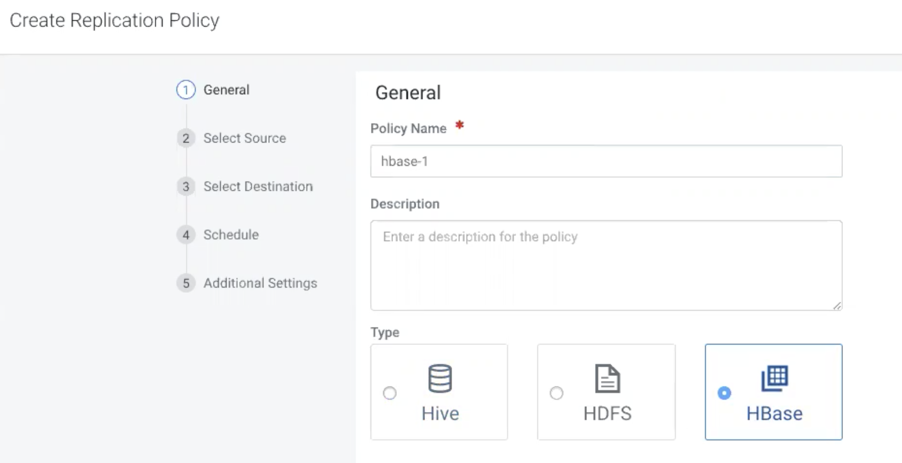
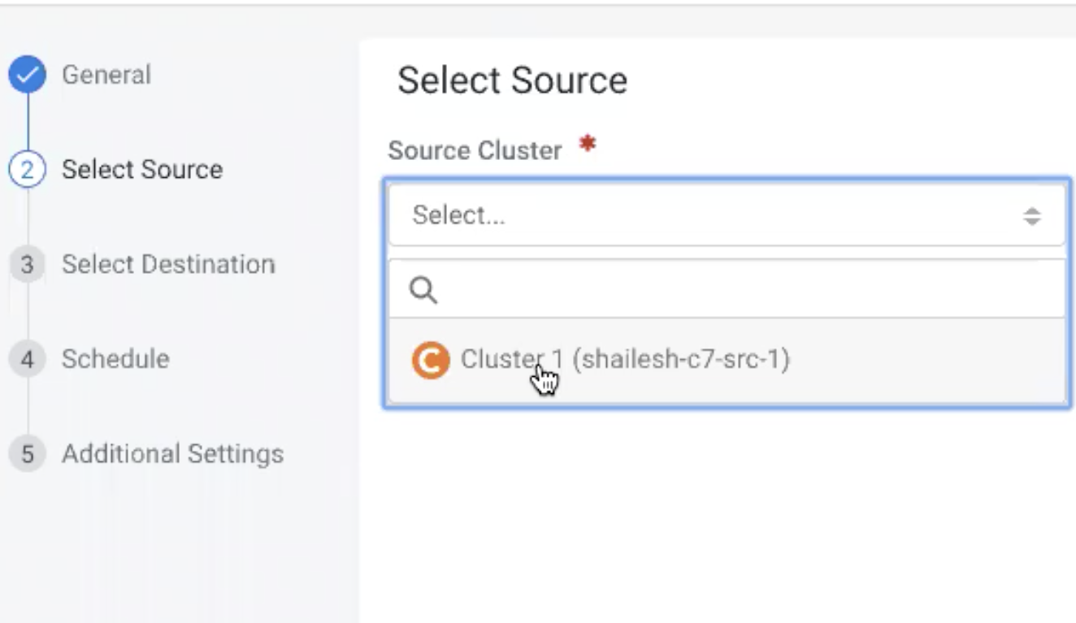
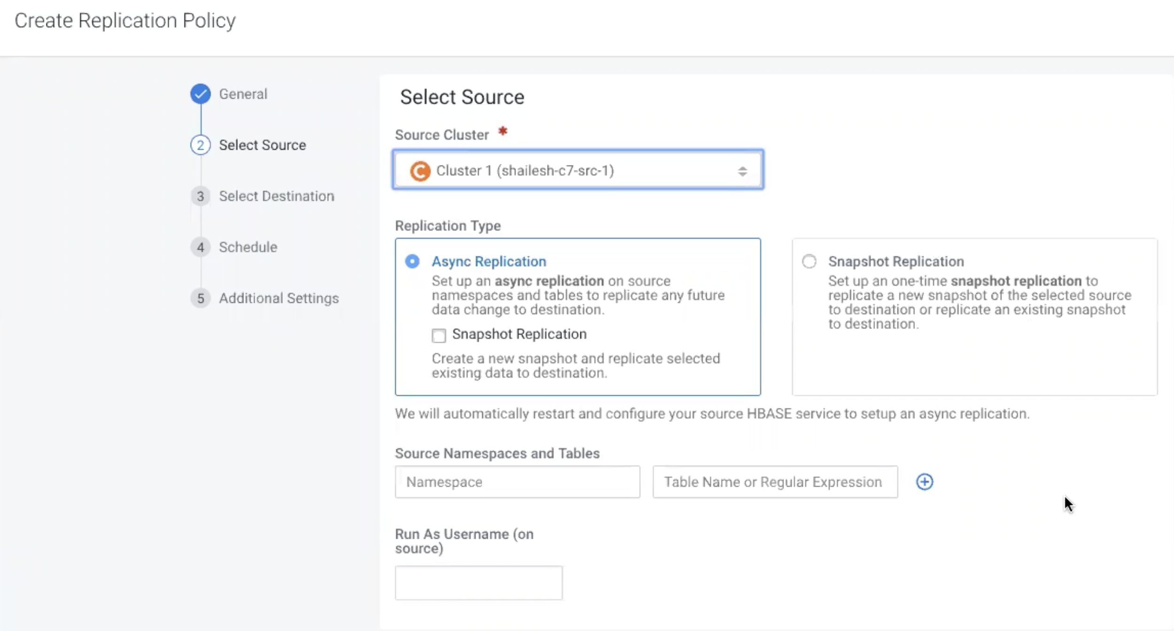
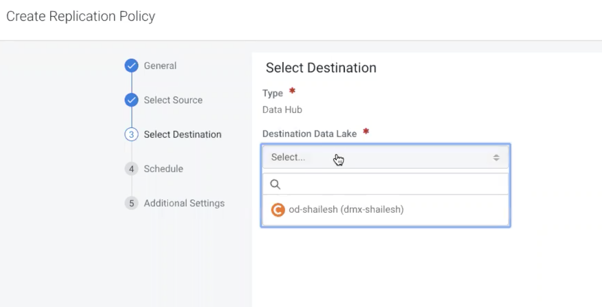
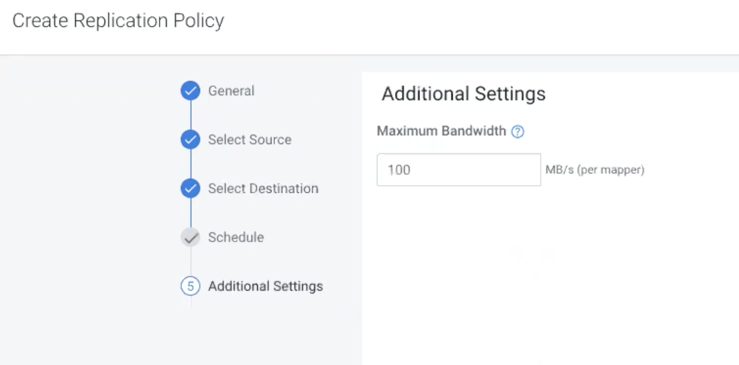
WIZARD BASED POLICY CREATION FOR OPERATIONAL DATABASE (HBASE/PHOENIX)
1
2
3
4
5
Notes:
Operational Database replication is coming in January and even simpler.

Slide 36
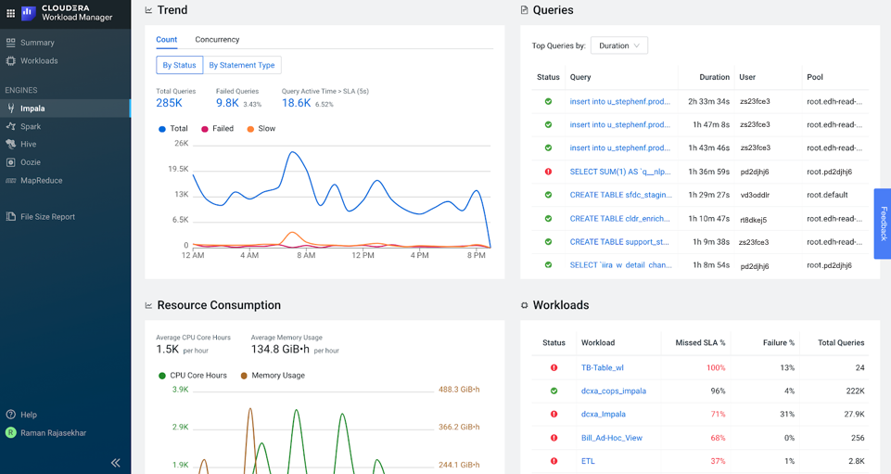
ACCELERATE UPGRADES WITH WORKLOAD MANAGER

Slide 37
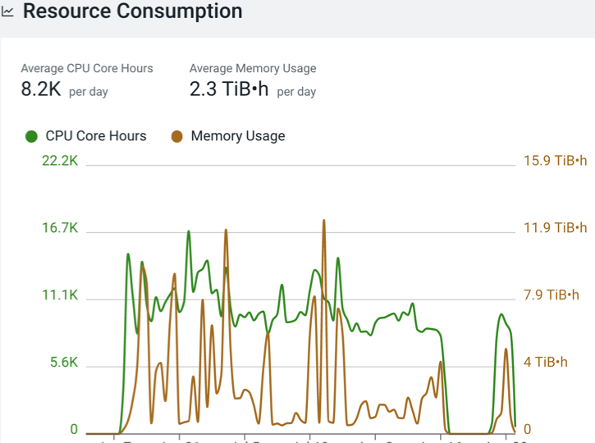
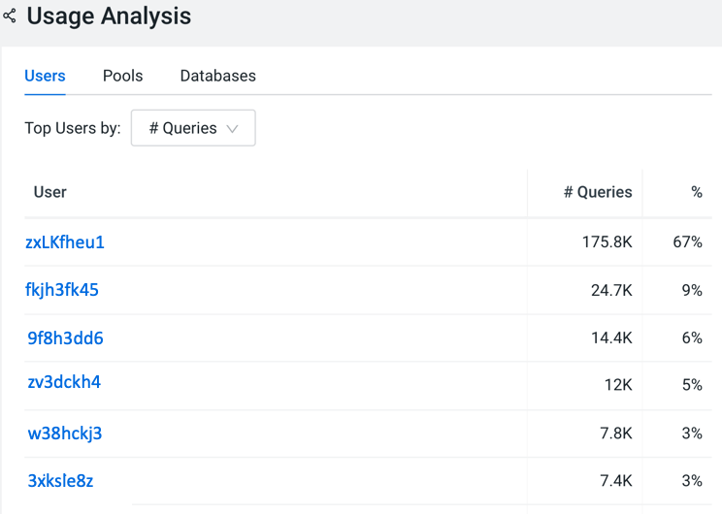
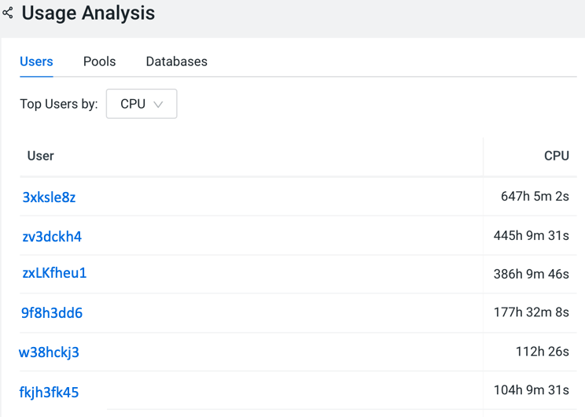
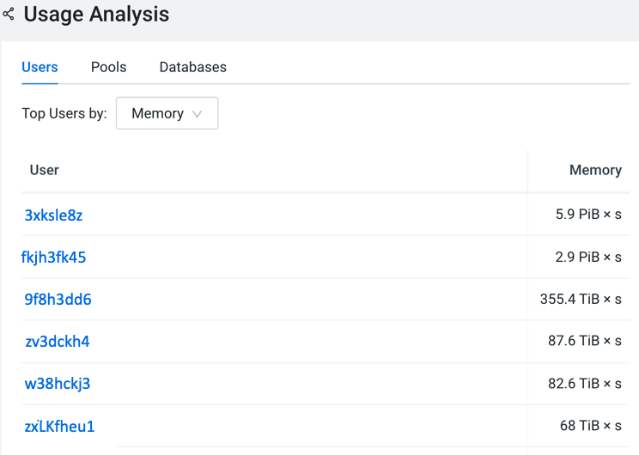
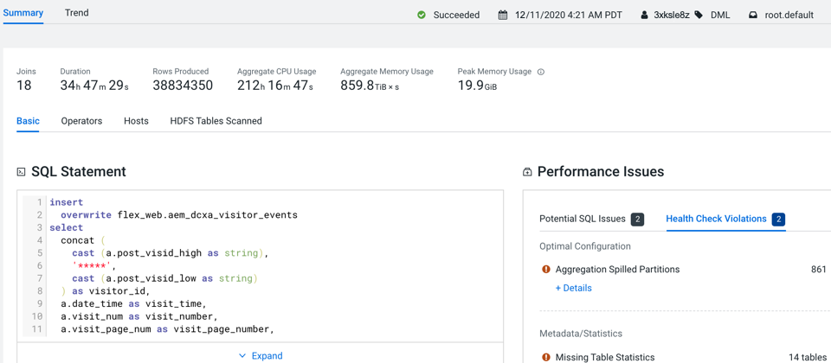
01 - Analyze Resource Consumption
02 | 1 - Identify Rogue Users
02 | 2 - Identify Rogue Users
02 | 3 - Identify Rogue Users
04 - Analyze Rogue User’s Queries / Jobs

Slide 38
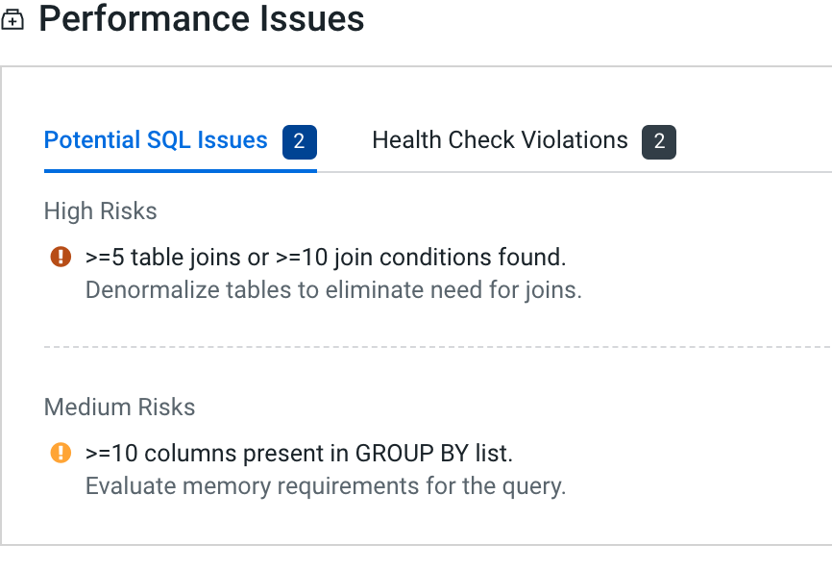




05 | 1 - Plan Optimization Pre/Post Upgrade
05 | 2 - Plan Optimization Pre/Post Upgrade
05 | 3 - Plan Optimization Pre/Post Upgrade
06 | 1 - Performance Benchmark Pre v/s Post Upgrade
06 | 2 - Performance Benchmark Pre v/s Post Upgrade

Slide 39
Additional Details on Migration

Slide 40
VERSION CHANGES (1 OF 2)
Component | CDH 5.16 | CDH 6.3 | CDP 7.1
Apache Hadoop | 2.6.0 | 3.0.0 | 3.1
Apache HBase | 1.2.0 | 2.1.4 | 2.2
Apache Hive | 1.1.0 | 2.1.1 | 3.1
Hue | 3.9.0 | 4.3.0 | 4.3
Apache Impala | 2.12.0 | 3.2.0 | 3.4
Apache Kudu | 1.7.0 | 1.10.0 | 1.12
Apache Solr | 4.10.3 | 7.4.0 | 8.4
Apache Oozie | 4.1.0 | 5.1.0 | 5.1
Apache Sentry | 1.5.1 | 2.1.0 | Replaced by Ranger2.0
Navigator | 2.15 | 6.3 | Replaced by Atlas2.0

Slide 41
VERSION CHANGES (2 of 2)
Component | CDH 5.16 | CDH 6.3 | CDP 7.1
Apache Spark | 1.6.0 | 2.4.0 | 2.4.5
Apache Kafka | 1.0.1 | 2.3.0 | 2.3.0
Apache Sqoop | 1.4.6 | 1.4.7 | 1.4.7
Apache ZooKeeper | 3.4.5 | 3.4.5 | 3.5.5
Apache Phoenix | 4.7.0 | 5.0.0 | 5.0
Apache Parquet | 1.5.0 | 1.9.0 | 1.10
Apache Avro | 1.7.6 | 1.8.2 | 1.8.2
Apache Flume | 1.6.0 | 1.9.0 | Replaced by NiFi
Apache Knox | - | - | 1.3
Apache TEZ | - | - | 0.9
Apache Zeppelin | - | - | 0.8

Slide 42
COMPONENT MIGRATION RECOMMENDATIONS
 | Approach | Tooling
Flume | Port to CFM (Apache NiFi) | No
Storm | Port to CSA (Apache Flink) | No
Sqoop2 | Port to Sqoop 1 (or Apache NiFi) | No
Pig | Port to Apache Spark | No
Crunch | Port to Apache Spark | No
YARN Fair Scheduler | Configure Capacity Scheduler in CM UI | Yes
Sentry | Migrate to Ranger | Yes
Navigator | Migrate to Atlas | Yes
Ambari | Migrate to Cloudera Manager | Yes

Slide 43
ON-PREM UPGRADE PREPARATION
Component | Approach
Spark | Migrate all jobs to Spark 2
JDK | Install JDK 1.8 on all nodes
OS | Upgrade all nodes to RHEL 7.6+
HDP | Upgrade to 2.6.5
CDH | Upgrade to 5.13 - 5.16 if older than 5.13
Pig/Crunch/Sqoop/Flume | Migrate to replacement (Spark, Flink, NiFi)
DB | Assess if DB upgrade required
3rd Party | Validate support/certification on CDP-DC

Slide 48

PRECAUTIONS FOR IN-PLACE UPGRADE
Testing before the upgrade is crucial. Almost all the problems encountered after the upgrade are caused by the early neglect of system testing or application testing
The test environment must be configured with similar parameters as the production environment, even if it may take a lot of time to perform consistent matching
Develop a detailed upgrade plan. It is best to accurately record the command that must be executed during the upgrade process, and it is not recommended to temporarily modify the steps during the upgrade.
The rollback operation is also very important. Even if we never plan to use rollback, testing the rollback steps makes us more at ease
Although data migration is not necessary for in-place upgrade, strongly recommend customers make data backups in advance
Major version upgrades usually have service interruption time, generally no more than 8 hours (scheduled at night/weekend time). Be sure to coordinate the downtime window of each business department on the platform. If you have special requirements, you can contact Cloudera to provide additional solutions

Slide 49
OVERALL IDEA OF MIGRATION UPGRADE
Build a new cluster of CDH/CDP
replication all the data from old cluster to new cluster
Since the amount of data in the old cluster is relatively large during the full copy process, it will take a long time, and new data will be written to the old cluster, so incremental copying is required
The amount of data for incremental copy is relatively small and the time required is relatively short. You can iterate multiple incremental copies until the final incremental copy time reaches an acceptable time range
Choose an appropriate time point, stop the application of the old cluster, ensure that no new data is written, and perform incremental copying. (If there is an application data supplementary recording mechanism, you can also use the data supplementary recording function to complete the data)
After the incremental copy is completed, theoretically the new and old cluster data is consistent, and the data consistency check starts
Finally, switch the cluster

Slide 50
Customer Story

Slide 51






CLOUDERA POWERING DATA-DRIVEN CUSTOMERS
At-scale migration from on-premises to public cloud for increased flexibility and scale
Enabling new growth opportunities via CDP Public Cloud and streaming analytics
Increasing ROI via a hybrid cloud for massively scalable, real-time data ingestion
Notes:
LinkedIn - Moving from two CDH datacenters in the East and West regions to CDP Public Cloud on Azure. Wanted to vacate the data centers and move everything to the cloud to combine workflows, more flexibility, autoscaling, automation, and consistency with their data. The cluster resizes itself based on how many resources it needs for the jobs they are doing. One of the biggest on-prem to cloud migration stories we have.
Reef - CDP public cloud solution replaced existing data warehouse. CDF, Flink, and Kafka used to ingest and process IoT and streaming data. Established data architecture to meet growth in data volume, reduce TCO, and meet GDPR and PII regulations. Reef primarily focuses on logistics and mobility, turning underutilized urban spaces into additional revenue by connecting people to local goods and services. The key way the company is doing this is by utilizing parking garages. By putting “virtual kitchens,” delivery only kitchens, COVID-19 testing sites, and lockers for grocery delivery within parking lots - Reef is creating additional revenue streams by transforming its parking garage assets into a vibrant mobility hub.
https://reeftechnology.com/
ExxonMobil - Replaced EMR with CDE and CDW in CDP public cloud. Now ingesting log data from 130,000 PC’s and all different types of cloud platforms around the world in real-time. This massive and global scalability from multiple environments has created a unified data downstream that many applications can consume for analytics, resulting in millions in ROI.

Slide 52


CUSTOMER UPGRADE: REGIONAL US BANK
CDH 5.14.2 to CDP PVC BASE 7.1.2
10
3
1PB
Weeks
Clusters
Data
CHALLENGE
SOLUTION
OUTCOMES
Need to modernize architecture to ingest real-time data using new CDP streaming capabilities while leveraging existing infrastructure and minimizing downtime
In-place upgrade to minimize downtime and risk for test, dev and production clusters. Cloudera PS supported upgrade planning, process and implementation
Successful upgrade to CDP PVC Base, enable use cases to leverage new capabilities: Apache Ranger, Atlas, Kafka, Hive 3
Notes:
September
The upgrade was driven by a task force that included the customer, Cloudera account team and Professional Services. The Cloudera team included a Professional Services Solution Architect and Service Delivery Manager. The customer team included several Hadoop administrators, a program manager, a database administrator and an enterprise architect. Additionally, individual application teams contributed to test and deploy their jobs. Some customers may also need to include platform/infrastructure, network and information security resources.

Slide 53
Cloudera PS & Training

Slide 54
SMARTSERVICES
Cloudera Professional Services to Enable the Path to CDP PVC Base
SMARTARCHITECTURE
Begin defining a hybrid strategy and architecture to modernize your analytics with CDP
Develop an architecture and roadmap to a tailored Enterprise Data Cloud strategy
SMARTDEPLOY
Quickly install and secure your first cluster on CDP Private Cloud based on best practices
Plan use case implementation with roadmap
SMARTUPGRADE
Enable CDP Private Cloud with either in-place upgrade or migration from existing CDH or HDP deployments
Sizing calculators assess time of engagement based on risk and complexity of environment
SMARTPRIVATE
Begin your analytics journey with secure platform deployment on PVC Experiences and pilot workload on CDW or CML
Includes OnDemand training license
Fixed Fee Offering
TRAINSMART
Now Available! Administrator Training: CDP Private Cloud Base

Slide 55


Slide 56
CLOUDERA EDUCATIONAL SERVICES
Supporting Customers’ Move to the Enterprise Data Cloud
CDP Public Cloud Admin
ADMINISTRATOR
DATA ANALYST
DEVELOPER
DATA SCIENTIST
AWS Fundamentals for CDP Pub. Cloud
Introduction to CDW
CDP Private Cloud Base Admin
CDP Security
CDP Private Cloud Fundamentals
Introduction to CML
CDP Data Governance
ALL AUDIENCES
Introduction to CDW
Hive/Impala
Data Viz
CDP Essentials
CDH/HDP to CDP
Delta Courses
Spark
Spark Application Performance Workshop
Flow Management with NiFi (CDF)
Stream Processing
(CDF)
Kafka Operations
(CDF)
FREE
CML
Data Scientist Training
DS/ML Modules
RELEASED
IN DEVELOPMENT
ROADMAP
cloudera.com/training.html
Notes:
CDP Delta courses were live by SKO

Slide 57
Key Resources

Slide 58
Key Bookmarks
CDP Upgrade/Migration https://docs.cloudera.com/cdp-private-cloud/latest/upgrade.html
Blog https://blog.cloudera.com/upgrade-journey-the-path-from-cdh-to-cdp-private-cloud/
Data Migration https://docs.cloudera.com/cdp/latest/data-migration/cdp-data-migration-guide.pdf
Upgrade Advisor https://my.cloudera.com/
Upgrade Advisor (External) https://www.cloudera.com/products/cdp-migration/migration-from-cdh.html?tab=0
Cloudera PS Packages https://www.cloudera.com/about/services-and-support/professional-services.html
Cloudera Trainings https://www.cloudera.com/about/training.html#

Slide 59
THANK YOU

